Slide 1

Data Mining
CS-772
Department of Computer Sciences

Slide 2
Knowledge Information Data
Data : Simple things; easily captured, structured, transferred, compressible and quantifiable
Information : Relevant and related data having some purpose; needs consensus on meaning and human mediation necessary
Knowledge : Valuable information from human mind; contextual; hard to capture electronically and structure; mostly tacit
Source : Adapted from Thomas H. Davenport, Information Ecology
Notes:
Knowledge is both an individual attribute and a collective attribute of the firm.
Knowledge is generally believed to have a location, either in the minds of humans or in specific business processes.
Knowledge is “sticky” and not universally applicable or easily moved.
Knowledge is thought to be situational and contextual. For example, you must know when to perform a procedure as well as how to perform it.
Tacit knowledge : Knowledge residing in the minds of employees that has not been documented. Like ride a bicycle.
i.e. Knowledge is a cognitive, even a physiological, event that takes place inside peoples’ heads.
Explicit knowledge : Knowledge that has been documented
It is also stored in libraries and records, shared in lectures, and stored by firms in the form of business processes and employee know-how. Knowledge can reside in e-mail, voice mail, graphics, and unstructured documents as well as structured

Slide 3
WISDOM
Decision Support Systems
Data Mining
OLAP
Knowledge
Information Systems
Information
Transaction Systems
DATA

Slide 4
Definition - DM and KDD
Data mining(DM) is a step in the knowledge discovery process consisting of particular data mining algorithms that, under some acceptable computational efficiency limitations, find patterns or models in data
Knowledge discovery in databases (KDD) (Fayyad et al, 1996), is the process of identifying valid, novel, potentially useful, and ultimately understandable patterns or models in data.

Slide 5
Data Mining
The automated extraction of hidden predictive information from (large) databases
Three key words:
Automated
Hidden
Predictive

Slide 6
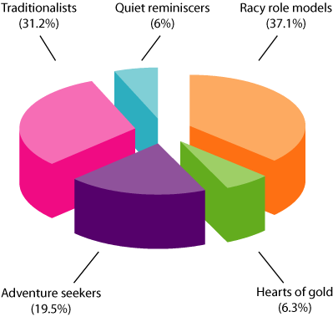
Data Mining Goals
Data description and summarization
Classification
Prediction
Association discovery
Dependency analysis
Segmentation
Google Segmentation
…..
Notes:
Summarization is a key data mining concept which involves techniques for finding a compact description of a dataset. Simple summarization methods such as tabulating the mean and standard deviations are often applied for data analysis, data visualization and automated report generation. Clustering is
another data mining technique that is often used to summarize large datasets.

Slide 7
Data Mining Algorithms
Associated Patterns
Decision Trees
Nearest Neighbor Classification
Neural Networks
Rule Induction
K-means Clustering
…..

Slide 8
Data Mining is NOT!
Data warehousing
SQL / Ad Hoc Queries / Reporting
Software Agents
Online Analytical Processing (OLAP)
Data Visualization
…..

Slide 9
The Data Explosion
Modern computer systems are accumulating data at an almost unimaginable rate and from a very wide variety of sources:
from point-of-sale machines in the high street to machines logging every cheque clearance, bank cash withdrawal and credit card transaction, to Earth observation satellites in space.
NASA Earth observation satellites generate a terabyte of data every day. This is more than the total amount of data ever transmitted by all previous observation satellites
The Human Genome project is storing thousands of bytes for each of several billion genetic bases.
As long ago as 1990, the US Census collected over a million million bytes of data.
Many companies maintain large Data Warehouses of customer transactions. A fairly small data warehouse might contain more than a hundred million transactions.
Notes:
There are vast amounts of data recorded every day on automatic recording
devices, such as credit card transaction files and web logs, as well as nonsymbolic
data such as CCTV recordings.
Alongside advances in storage technology, which increasingly make it possible
to store such vast amounts of data at relatively low cost whether in commercial
data warehouses, scientific research laboratories or elsewhere, has come a
growing realisation that such data contains buried within it knowledge that
can be critical to a company’s growth or decline, knowledge that could lead
to important discoveries in science, knowledge that could enable us accurately
to predict the weather and natural disasters, knowledge that could enable us
to identify the causes of and possible cures for lethal illnesses, knowledge that
could literally mean the difference between life and death. Yet the huge volumes
involved mean that most of this data is merely stored—never to be examined
in more than the most superficial way, if at all. It has rightly been said that
the world is becoming ‘data rich but knowledge poor’.

Slide 10
Magnitude of Data
GIGA 9
.
.
TERA 12
.
.
PETA 15
.
.
EXA 18
.
.
ZETTA 21
.
.
YOTTA 24
Human brain capacity 2.5 PETABYTES
Total digital data created 422 EXABYTES (2008)
Web size - 98 PETABYTES (2010)
Total genome sequences of all people on Earth 4.75 EXABYTES
Web users - 2 Billion + (2011)
World’s digital storage capacity 1 ZETTABYTE (2011)
Digital data created 1.8 ZETTABYTES (2011) 2.7 ZB (2012)
Digital Data to be produced - 35 ZETTABYTES (by 2020 )
Drastic price reduction in per Gigabyte production of storage
=> All data is being or is going to be conserved!
=> Huge data centres
1 bit on 12 atoms …. 1 bit on 1000000 atoms
IDC Digital Universe 2010/ Popular Science Nov 2011/ IBM
Notes:
eBay 6.5 PB 2009, Google 1 PB of new data every 3 days 2009 : It is said that Google is today the largest manufacturer of Computer Hardware –
To handle the data - it designs and produces its own hardware. Maybe becasue once in a security workshop, an expert shared a case in which sensitive company asked the proprietory vendors to submitt an AFFADAVID (registered from court) paper saying there is no backdoor chip in the servers. Not one company went for the selling. The company made their servers from off the shelf motherboards and processors!
The Guardian Tuesday 29 May 2012 - Cyber-attack concerns raised over Boeing 787 chip's 'back door‘
Sergei Skorobogatov , Christopher Woods, (Cambradge Univ. UK) Breakthrough silicon scanning discovers backdoor in military chip. Cryptographic Hardware and Embedded Systems Workshop (CHES-2012), 9-12 September 2012, LNCS 7428, Springer, ISBN 978-3-642-33026-1, pp.23-40.
Researchers claim chip used in military systems and civilian aircraft has built-in function that could let in hackers
Talks about Yottabyte of data is on the boards…
In a presentation at IBM, ECAI 2012 – A researcher from IBM, Haifa said for 2020 onword we should start thinking how to handle Yottabyte!
2^30, 40, 50, 60, 70, 80 in binary from Giga to Yotta
At IBM bit on 12 atoms- Currently it takes about a million atoms to store a bit on a modern hard-disk. Below 12 atoms the researchers found that the bits randomly lost information, owing to quantum effects. More than a factor of 80000 to current disk size to volume ratio …. Density of data
http://www-03.ibm.com/press/us/en/pressrelease/36473.wss
An example of sensor and machine data is found at the Large Hadron Collider at CERN, the European Organization for Nuclear Research. CERN scientists can generate 40 terabytes of data every second during experiments.
Similarly, Boeing jet engines can produce 10 terabytes of operational information for every 30 minutes they turn. A four- engine jumbo jet can create 640 terabytes of data on just one e Atlantic crossing; multiply that by the more than 25,000 flights flown each day, and you get an understanding of the impact that sensor and machine-produced data can make on a BI environment

Slide 11
The world is becoming
‘data rich but knowledge poor’

Slide 12
Knowledge Discovery
Knowledge Discovery has been defined as the ‘non-trivial extraction of implicit, previously unknown and potentially useful information from data’.
It is a process of which data mining forms just one part, although a central one.
Notes:
trivial is frequently used for objects (for example, groups or topological spaces) that have a very simple structure
nontrivial in Technology: Requiring real thought or significant computing power. Often used as anunderstated way of saying that a problem is quite difficult or impractical, or even entirely unsolvable
Implicit: implied, rather than expressly stated

Slide 13
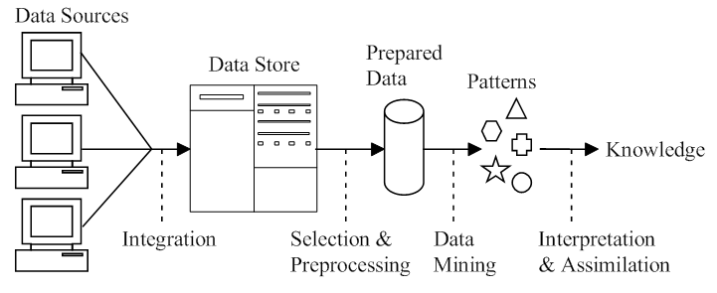
Knowledge Discovery Process
Notes:
Data comes in, possibly from many sources. It is integrated and placed
in some common data store. Part of it is then taken and pre-processed into a
standard format. This ‘prepared data’ is then passed to a data mining algorithm
which produces an output in the form of rules or some other kind of ‘patterns’.
These are then interpreted to give—and this is the knowledge
discovery—new and potentially useful knowledge.

Slide 14
Labelled and Unlabelled Data
Instances: A dataset of examples
Attributes : Each example comprises the values of a number of variables, which in data mining are often called attributes.
There are two types of data, which are treated in radically different ways.
If there is a specially designated attribute and the aim is to use the data given to predict the value of that attribute for instances that have not yet been seen.
Data of this kind is called labelled.
Data mining using labelled data is known as supervised learning.
If the designated attribute is categorical, i.e. it must take one of a number of distinct values such as ‘very good’, ‘good’ or ‘poor’, or (in an object recognition application) ‘car’, ‘bicycle’, ‘person’, ‘bus’ or ‘taxi’ the task is called classification.
If the designated attribute is numerical, e.g. the expected sale price of a house or the opening price of a share on tomorrow’s stock market, the task is called regression.
Data that does not have any specially designated attribute is called unlabelled.
Data mining of unlabelled data is known as unsupervised learning.
Here the aim is simply to extract the most information we can from the data available.

Slide 15
Application Types
Classification
Numerical Prediction
Association And Clustering

Slide 16
Supervised Learning: Classification
Classification is one of the most common applications for data mining.
It corresponds to a task that occurs frequently in everyday life. e.g.
A hospital may want to classify medical patients into those who are at high, medium or low risk of acquiring a certain illness
An opinion polling company may wish to classify people interviewed into those who are likely to vote for each of a number of political parties or are undecided, or
We may wish to classify a student project as distinction, merit, pass or fail.

Slide 17
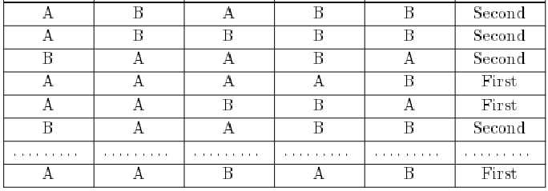
Degree Classification Data
SoftEng DM HCI AAA Project CLASS
Classification is one form of prediction, where the value to be predicted is a label
Notes:
This example shows a typical situation (Figure 2). We have a dataset in
the form of a table containing students’ grades on five subjects (the values of
attributes SoftEng, DM, HCI, AAA and Project) and their overall degree
classifications. The row of dots indicates that a number of rows have been
omitted in the interests of simplicity. We want to find some way of predicting
the classification for other students given only their grade ‘profiles’.

Slide 18
Nearest Neighbor Matching.
This method relies on identifying (say) the five examples that are ‘closest’ in some sense to an unclassified one.
If the five ‘nearest neighbors' have grades Second, First, Second, Second and Second
We might reasonably conclude that the new instance should be classified as ‘Second’.

Slide 19
Classification Rules
We look for rules that we can use to predict the classification of an unseen instance, for example:
IF SoftEng = A AND Project = A THEN Class = First
IF SoftEng = A AND Project = B AND DM = B THEN Class = Second
IF SoftEng = B THEN Class = Second

Slide 20
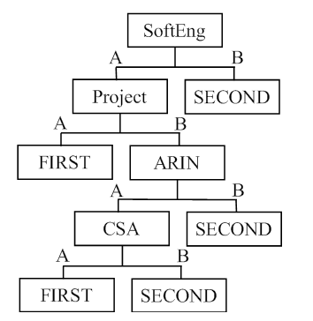
Classification Tree
One way of generating classification rules is via an intermediate tree-like structure called a classification tree or a decision tree.
DM
AAA

Slide 21
Supervised Learning: Numerical Prediction
Numerical prediction (often called regression) is another type of Supervised Learning.
In this case we wish to predict a numerical value, such as a company’s profits or a share price.
A very popular way of doing this is to use a Neural Network, often called by the simplified name Neural Net).
This is a complex modeling technique based on a model of a human neuron.
A neural net is given a set of inputs and is used to predict one or more outputs.

Slide 22
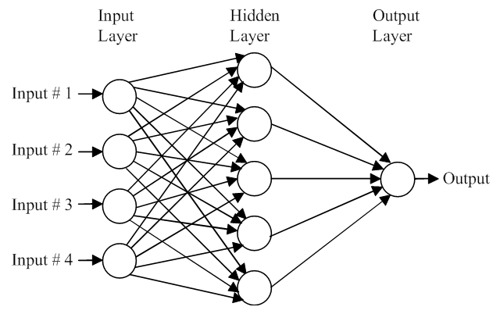
Neural Net
Notes:
A neural network is a “connectionist” computational system. The computational systems we write are procedural; a program starts at the first line of code, executes it, and goes on to the next, following instructions in a linear fashion. A true neural network does not follow a linear path. Rather, information is processed collectively, in parallel throughout a network of nodes (the nodes, in this case, being neurons).

Slide 23
Unsupervised Learning: Association Rules
Sometimes we wish to use a training set to find any relationship that exists amongst the values of variables, generally in the form of rules known as association rules.
There are many possible association rules derivable from any given dataset, most of them of little or no value, so it is usual for association rules to be stated with some additional information indicating how reliable they are,

Slide 24
Association Rules : Example
A common form of this type of application is called ‘market basket analysis’.
If we know the purchases made by all the customers at a store for say a week, we may be able to find relationships that will help the store market its products more effectively in the future.
For example, the rule
IF cheese AND milk THEN bread (probability = 0.7)
indicates that 70% of the customers who buy cheese and milk also buy bread,
So it would be sensible to move the bread closer to the cheese and milk counter, if customer convenience were the prime concern, or
to separate them to encourage impulse buying of other products if profit were more important.

Slide 25
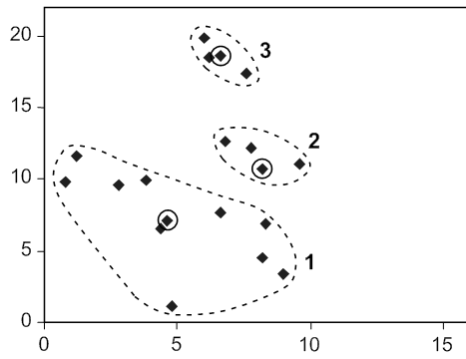
Unsupervised Learning: Clustering
Clustering algorithms examine data to find groups of items that are similar. For example,
an insurance company might group customers according to income, age, types of policy purchased or prior claims experience.
In a fault diagnosis application, electrical faults might be grouped according to the values of certain key variables

Slide 26
Data is Critical!
The data itself is critical
Accuracy not always the most important measure of data mining
Algorithms aren’t as important as some people think
If you can’t understand the patterns discovered with data mining, you are unlikely to act on them (or convince others to act)

Slide 27
Convergence of Three Technologies
Increased
Computing
Power
Statistical &
Learning
Algorithms
Improved Data
Collection &
Management
DM

Slide 28
Data Mining: Issues
Social
Data Integrity
Relational vs Multi-dimensional Data
Cost
2

Slide 29
Social Issue
One of the key issues raised by data mining technology is not a business or technological one, but a social one. It is the issue of individual privacy. Data mining makes it possible to analyze routine business transactions and glean a significant amount of information about individuals buying habits and preferences.

Slide 30
Data Integrity Issue
Another issue is that of data integrity. Clearly, data analysis can only be as good as the data that is being analyzed. A key implementation challenge is integrating conflicting or redundant data from diffèrent sources.
For example, a bank may maintain credit cards accounts on several different databases. The addresses (or even the names) of a single cardholder may be different in each. Software must translate data from one system to another and select the address most recently entered.

Slide 31
Relational vs Multi-dimensional Issue
Setting up a relational database structure or a multidimensional one.
In a relational structure, data is stored in tables, permitting ad hoc queries.
In a multidimensional structure, on the other hand, sets of cubes are arranged in arrays, with subsets created according to category.
While multidimensional structures facilitate multidimensional data mining, relational structures thus far have performed better in client/server environments.
And, with the explosion of the Internet, the world has become one big client/server environment.

Slide 32
Cost Issue
System hardware costs have dropped dramatically during past years
Data mining and data warehousing tend to be self-reinforcing.
The more powerful the data mining queries, the greater the utility of the information being gleaned from the data, and the greater the pressure to increase the amount of data being collected and maintained, which increases the pressure for faster, more powerful data mining queries.
This increases pressure for larger, faster systems, which are more expensive.
Notes:
to strengthen with some added piece, support, or material

Slide 33
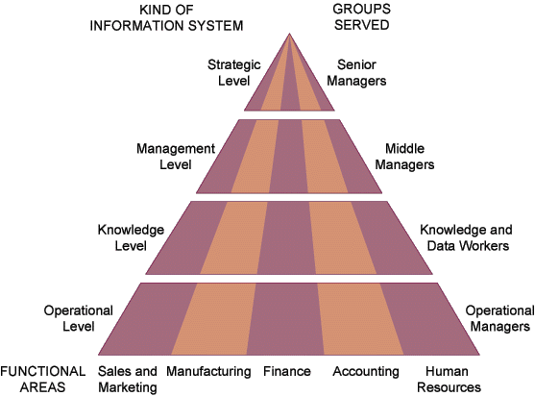
KEY SYSTEM APPLICATIONS IN THE ORGANIZATION
Types of Information Systems

Slide 34
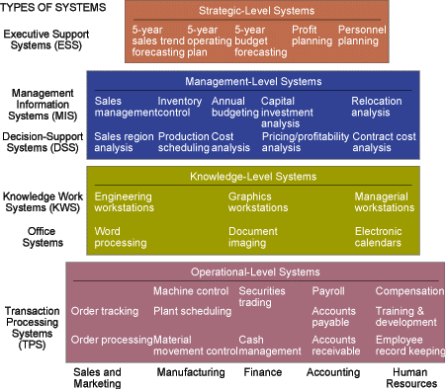
MAJOR TYPES OF SYSTEMS IN ORGANIZATIONS

Slide 35
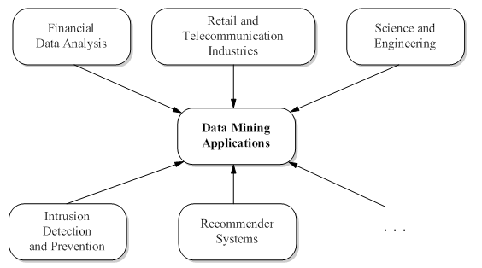
Data Mining Application Domains

Slide 36
Applications of Data Mining
analysis of organic compounds
automatic abstracting
credit card fraud detection
electric load prediction
financial forecasting
medical diagnosis
predicting share of television audiences
product design
real estate valuation
targeted marketing
thermal power plant optimisation
toxic hazard analysis
weather forecasting
Notes:
-- a supermarket chain mines its customer transactions data to optimise targeting
of high value customers
– a credit card company can use its data warehouse of customer transactions
for fraud detection
– a major hotel chain can use survey databases to identify attributes of a
‘high-value’ prospect
– predicting the probability of default for consumer loan applications by improving
the ability to predict bad loans
– reducing fabrication flaws in VLSI chips
– data mining systems can sift through vast quantities of data collected during
the semiconductor fabrication process to identify conditions that are causing
yield problems
– predicting audience share for television programmes, allowing television executives
to arrange show schedules to maximise market share and increase
advertising revenues
– predicting the probability that a cancer patient will respond to chemotherapy,
thus reducing health-care costs without affecting quality of care.

Slide 37
Assignment
You have analyzed/developed some transaction system in your last four years of computer science education
Select one such transaction system and think about a data mining problem which can be formulated from the data of the transaction system.
Write approximately 1000 words, describing the transaction system and the system related possible data mining problem.
Testing :
English
Novelty of Idea
Reference
Deadline Thursday 18-09-2014
Assignment will be passed through Turnitin software (used for checking plagiarism …) - Zero marks for plagiarized assignment.
Marks 5

Slide 38


